Slide 1
European borders Committee

Slide 2
1. Where are the borders of the European Union?
Northern borders:Belgium, Finland, Germany, Netherlands, Sweden
Eastern borders:Bulgaria, Cyprus, Estonia, Finland, Greece, Hungary, Latvia, Lithuania, Poland, Romania, Slovakia
Southern borders:Cyprus, France, Greece, Italy, Portugal, Spain
Western borders:France, Ireland, Portugal, Spain, United Kingdom

Slide 3
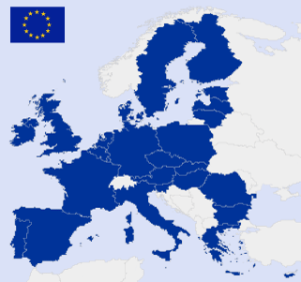

Slide 4
2. Conditions for joining the EU
In the EU are 28 member states, but Europe includes 50 countries.
We think every country in Europe should get the chance to join the EU.
Therefore they need certain conditions:

Slide 5
human rights
democracy
equal rights
freedom of speech
health insurance coverage
access for clean drinking water
regulated education for everyone
social help (Harz IV)
freedom of religion
press freedom
offical transport

Slide 6
3. How far can the EU be enlarged?
Just the countries which are part of Europe have the possibility to become a member of the EU.
only in Europe | worldwide
- corrupt | - minerals from e.g. Africa
- can not control people in other states | - safe other countries
- debts | - help to develop

Slide 7
statement: Is the EU already big enough or not?
NO | YES
- “rich countries” could help | - enough problems
- if a European country fulfills the conditions, the EU is obliged to let them in | → first help the EU countries
- cultural diversity | - would turn EU into a mini-UN
- successive enlargement would bring new ideas | - the larger the EU becomes, the less likely it is to develop into a true political union
 | - their economies in the East would not survive the competition and they would become dependant to the West

